Slide 1
Digital Portfolio
STUDENT NAME: SHASHVATH SRIRAM
REGISTER NO AND NMID: 222406205
DEPARTMENT: Computer Science with Data Science
COLLEGE: SRM ARTS AND SCIENCE COLLEGE/MADRAS UNIVERSITY

Slide 2
STUDENT DIGITAL PORTFOLIO

Slide 3


AGENDA
Problem Statement
Project Overview
End Users
Tools and Technologies
Portfolio design and Layout
Features and Functionality
Results and Screenshots
Conclusion
Github Link
3/21/2024 Annual Review

Slide 4

PROBLEM STATEMENT
In a rapidly evolving digital world, students need an effective way to showcase their academic progress, skills, and achievements beyond traditional methods like resumes or paper portfolios. However, many lack a centralized platform to present their work professionally and reflect on their learning journey. This limits opportunities for personal growth, academic recognition, and career advancement. A student digital portfolio addresses this gap by providing an organized, accessible, and customizable space to display projects, certifications, and reflections. It empowers students to take ownership of their learning, develop digital literacy, and present a holistic view of their capabilities to educators and future employers.

Slide 5

PROJECT OVERVIEW
The student digital portfolio project focuses on creating a personalized online platform where students can showcase their academic work, skills, achievements, and personal growth. The goal is to help students organize and present their learning journey in a meaningful and professional way. By using digital tools like Google Sites, Wix, or Notion, students compile essays, projects, certifications, and reflections into one accessible space. This project not only enhances digital literacy and creativity but also encourages self-assessment and goal-setting. The portfolio serves as a valuable resource for academic evaluation, college applications, and future career opportunities.

Slide 6

WHO ARE THE END USERS?
The end users of a student digital portfolio include students, teachers, parents, college admissions officers, and potential employers. Students are the primary users, using the portfolio to document and reflect on their learning, showcase achievements, and support applications. Teachers use it to assess student progress and provide feedback, while parents view it to monitor academic growth. College admissions officers and employers review portfolios to evaluate a student’s skills, creativity, and potential beyond grades. Mentors and counselors may also use the portfolio to guide academic and career decisions. Together, these users benefit from the portfolio’s comprehensive view of student development.

Slide 7

TOOLS AND TECHNIQUES
Tools and techniques for creating a student digital portfolio include platforms like Google Sites, Wix, WordPress, Notion, and Adobe Portfolio, which allow students to design and organize content with ease. Canva and Figma can be used for creating visuals and graphics, while Google Drive or OneDrive help store and embed documents. Techniques include structuring content by subject or skill, embedding multimedia (videos, images, presentations), and writing personal reflections. Using templates, consistent formatting, and navigation menus ensures a clean, user-friendly design. These tools and methods help students showcase their achievements, creativity, and growth in a professional, accessible format.

Slide 8
POTFOLIO DESIGN AND LAYOUT
The design and layout of a student digital portfolio should be clean, organized, and easy to navigate. A homepage introduces the student with a photo, bio, and purpose statement. Key sections can include Academics, Projects, Skills, Achievements, Reflections, and Contact Information. Use a consistent color scheme, readable fonts, and clear headings. Include visuals like images, videos, or infographics to enhance engagement. Navigation menus should be simple and accessible across all pages. Each section should highlight specific work with brief descriptions or reflections. A well-structured layout helps present the student’s journey, skills, and growth in a professional and compelling way.
8

Slide 9
FEATURES AND FUNCTIONALITY
A student digital portfolio should feature easy navigation with clear menus and sections for academics, projects, skills, reflections, and achievements. It should support multimedia uploads like images, videos, PDFs, and links to external work (e.g., GitHub). Responsive design ensures accessibility across devices. Editable templates allow customization to showcase individual style. The portfolio should include a contact page with social media or email links. Integration with cloud storage helps manage files efficiently. Reflection sections encourage self-assessment, while password protection or privacy settings safeguard sensitive information. Overall, these features create a dynamic, professional platform for students to present their growth and accomplishments.

Slide 10
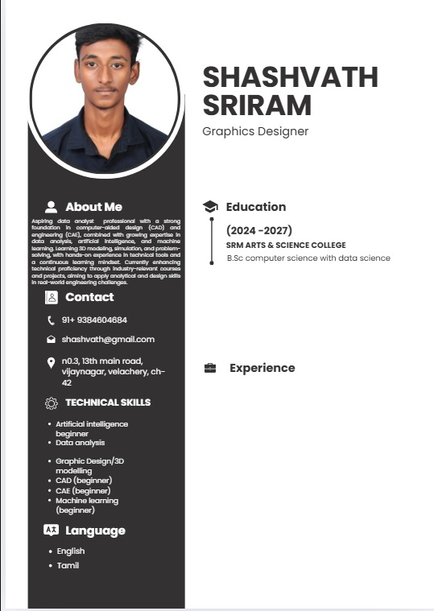

RESULTS AND SCREENSHOTS
3/21/2024 Annual Review
10

Slide 11
CONCLUSION
A student digital portfolio is an essential tool that empowers students to take ownership of their learning and showcase their academic achievements, skills, and personal growth in a professional, organized manner. It bridges the gap between traditional assessments and modern digital expectations, providing a versatile platform accessible anytime, anywhere. By integrating multimedia elements and reflections, portfolios encourage creativity, self-assessment, and goal-setting. They also serve as valuable resources for teachers, parents, admissions officers, and employers to evaluate a student’s potential holistically. Ultimately, a well-crafted digital portfolio prepares students for future academic and career opportunities in an increasingly digital world.
11

